Slide 1
MA679
Physical Therapy Project
Week 3 Update: Early Results
William Zen, Zara Waheed, Pruthvi Bharadwaj

Slide 2
Week Overview
Fit an autoencoder
Defined functions to calculate mean squared error for different models attempted
Compared these models based on the MSE
Notes:
This week we worked on fitting an Autoencoder and comparing the different models we’ve tried. We did this by calculating the MSE for each one.

Slide 3
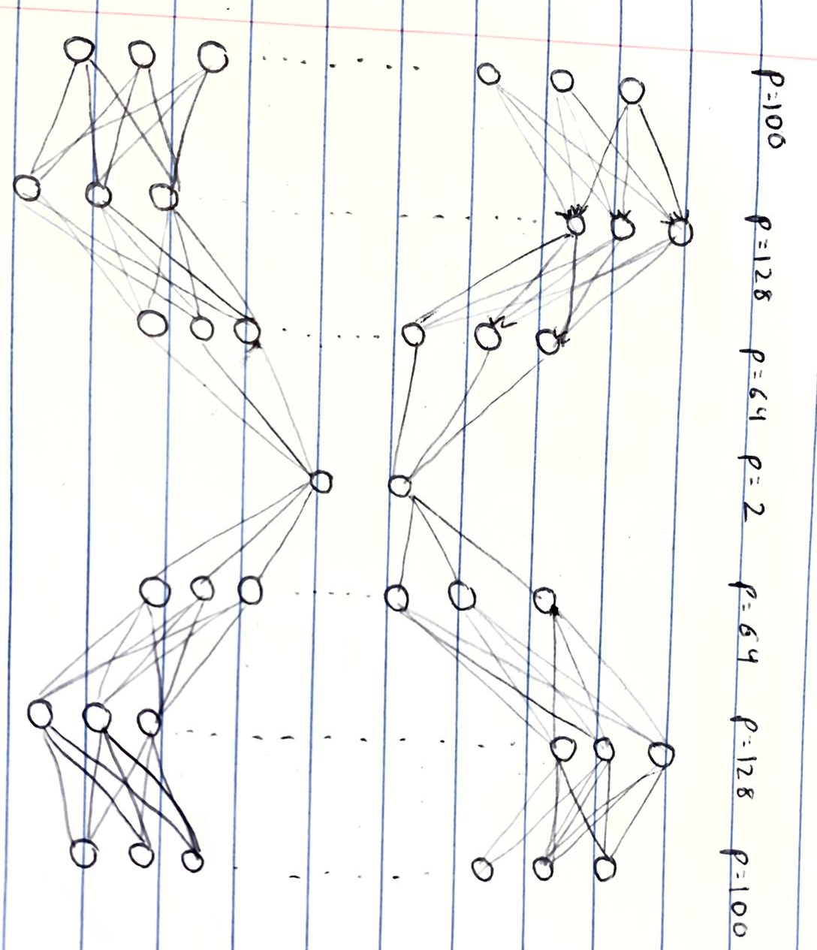
Autoencoder
ReLU = True
Regularization Parameter = 0.2
Notes:
We made an autoencoder that encodes the data using a neural network.
The encoded data has the same of number of rows as the original data but only a few columns.
We can change the number of columns, so the encoded data can be a feature or set of features.
We decode the data by taking the encoded data and almost using a reverse of the original neural network.
The decoded data can be compared to the original data to see how well the encoded data represents the original data.

Slide 4
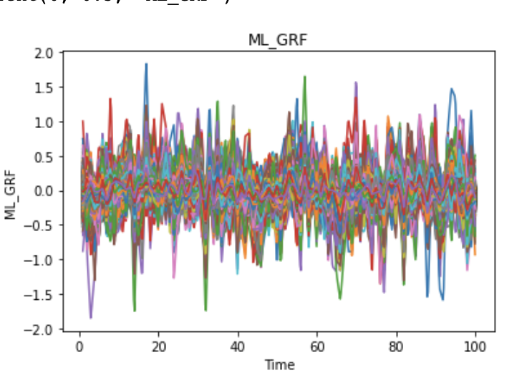
Autoencoder - ML_GRF
Force Direction | MSE
Medial Lateral | 1248.89

Slide 5
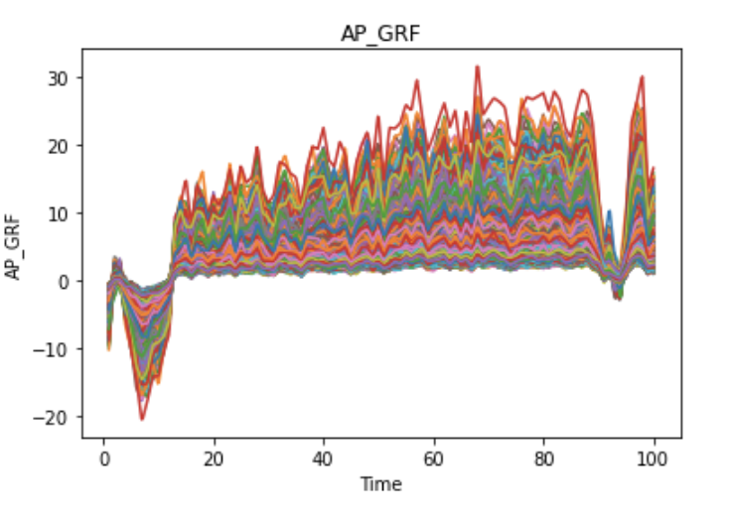
Autoencoder - AP_GRF
Force Direction | MSE
Anterior Posterior | 6830.6

Slide 6
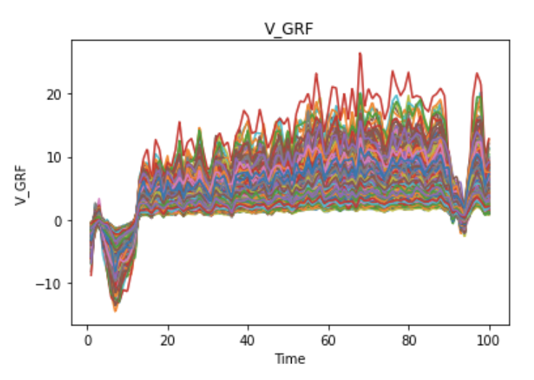
Autoencoder - V_GRF
Force Direction | MSE
Vertical | 462693.92

Slide 7
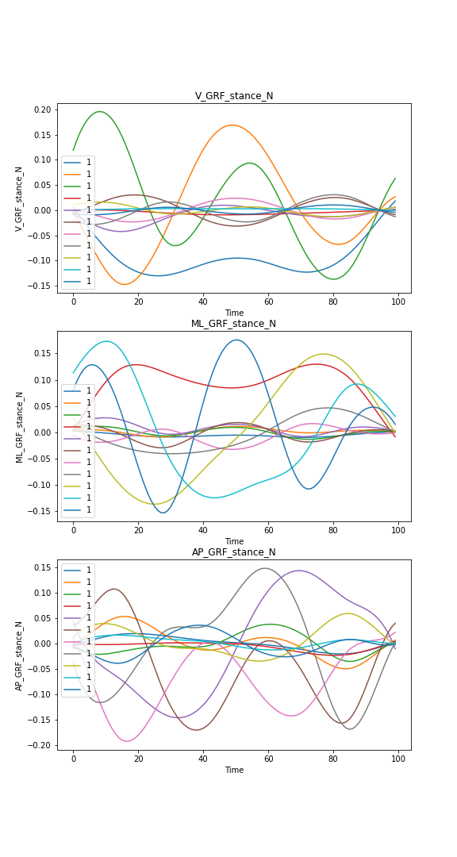
MFPCA
Force Direction | MSE
Anterior Posterior | 251.86
Medial Lateral | 89.24
Vertical | 1799.06
Notes:
For Multivariate FPCA we calculated MSE for each variable

Slide 8
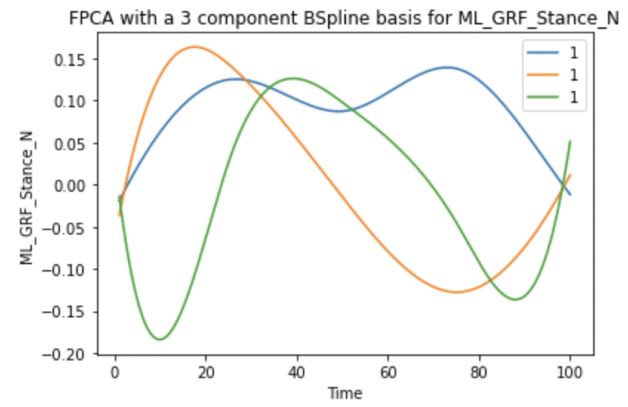
FPCA - ML_GRF
Force Direction | MSE
Anterior Posterior | 3.68
Total Variance Explained | 92.1%
PC1 | 77.5%
PC2 | 8.3%
PC3 | 6.3%

Slide 9
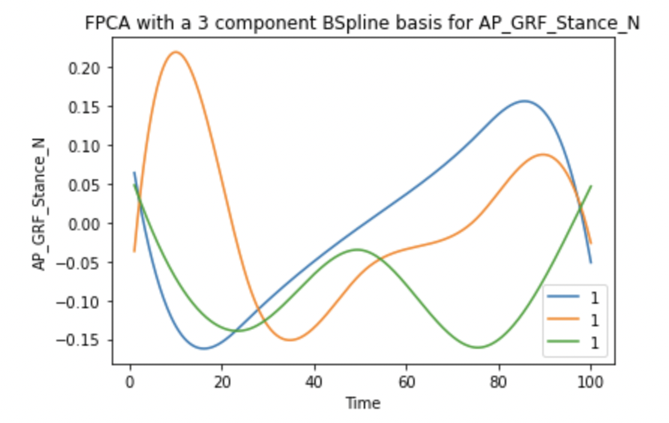
FPCA - AP_GRF
Force Direction | MSE
Anterior Posterior | 37.10
Total Variance Explained | 90.6%
PC | 74.9%
PC2 | 9.4%
PC3 | 6.2%

Slide 10
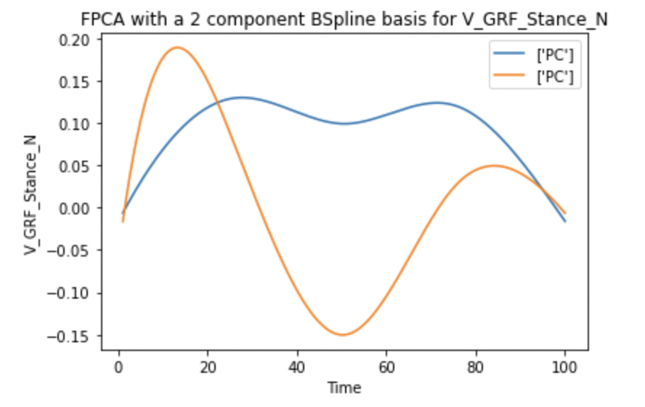
FPCA - V_GRF
Force Direction | MSE
Anterior Posterior | 75.12
Total Variance Explained | 93.3%
PC1 | 80.4%
PC2 | 12.9%

Slide 11
Next Steps
Try altering the Autoencoder specifications and improve the model
Improve the MFPCA model as well
Try fitting a Variational Autoencoder

Slide 12
The End

